Slide 1
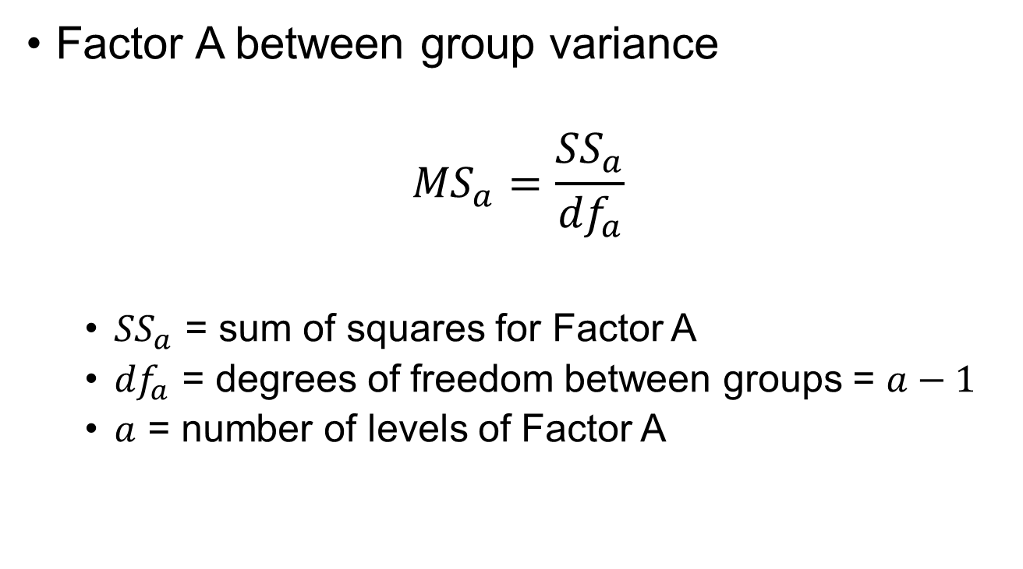
Between Group Variance
Factor A between group variance
$${MS}_{a}=\frac{{SS}_{a}}{{df}_{a}}$$
${SS}_{a}$ = sum of squares for Factor A
${df}_{a}$ = degrees of freedom between groups = $a−1$
$a$ = number of levels of Factor A

Slide 2
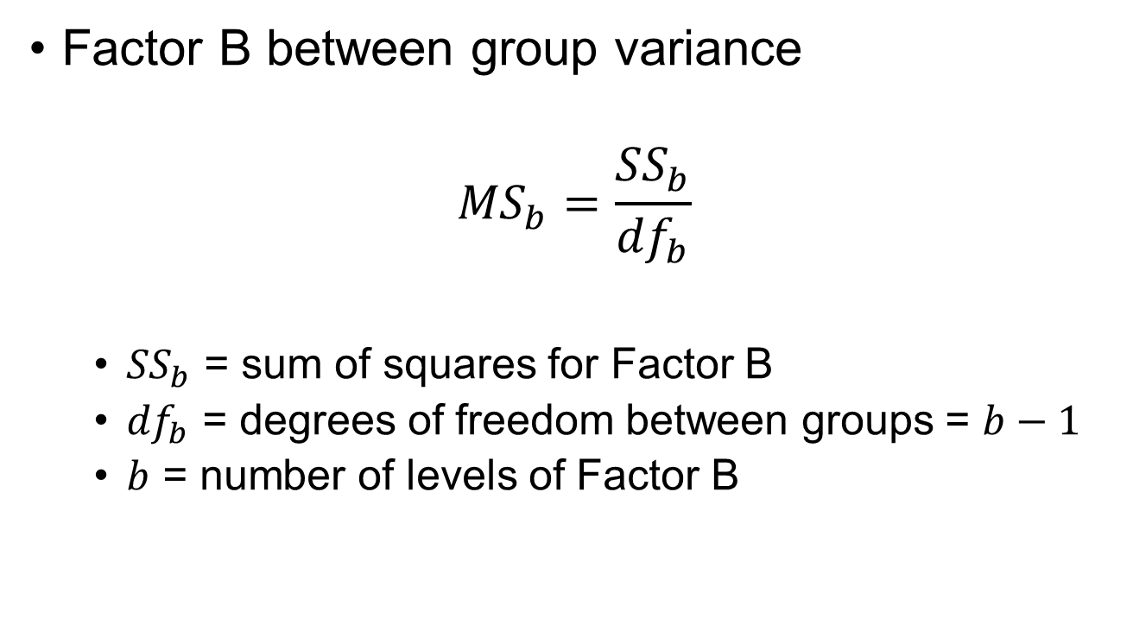
Between Group Variance
Factor B between group variance
$${MS}_{b}=\frac{{SS}_{b}}{{df}_{b}}$$
${SS}_{b}$ = sum of squares for Factor B
${df}_{b}$ = degrees of freedom between groups = $b−1$
$b$ = number of levels of Factor B

Slide 3
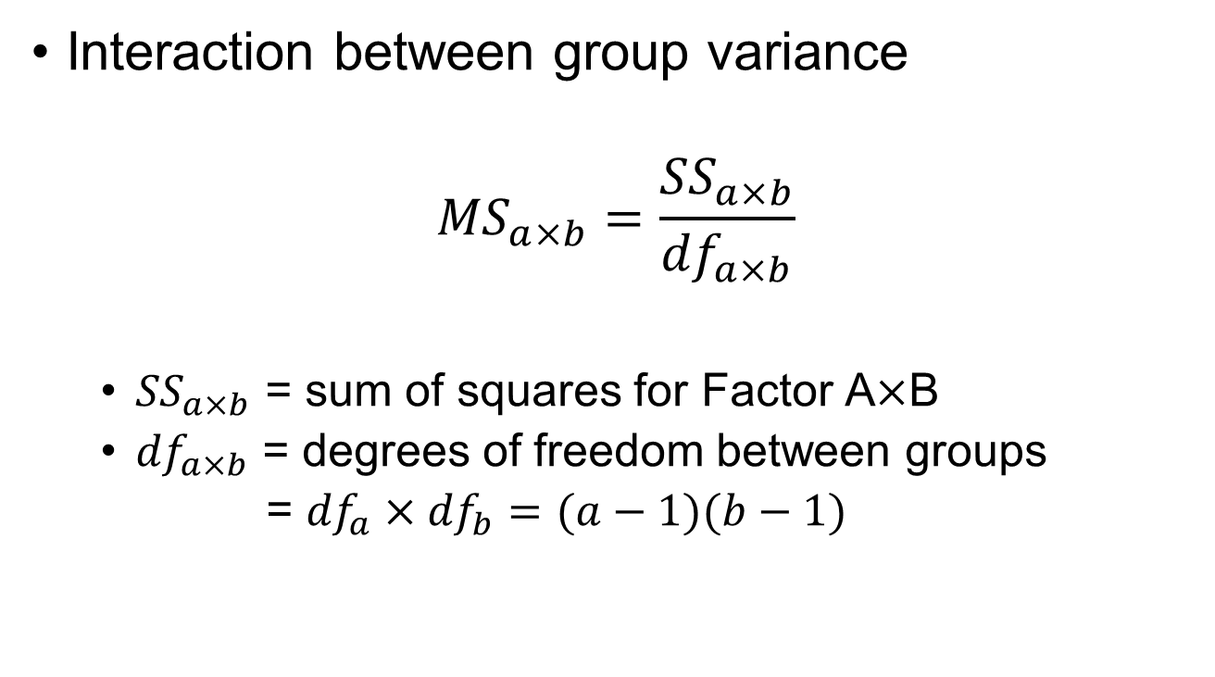
Between Group Variance
Interaction between group variance
$${MS}_{a×b}=\frac{{SS}_{a×b}}{{df}_{a×b}}$$
${SS}_{a×b}$ = sum of squares for Factor $\text{A}\text{×}\text{B}$
${df}_{a×b}$ = degrees of freedom between groups
= ${df}_{a}×{df}_{b}=(a−1)(b−1)$

Slide 4
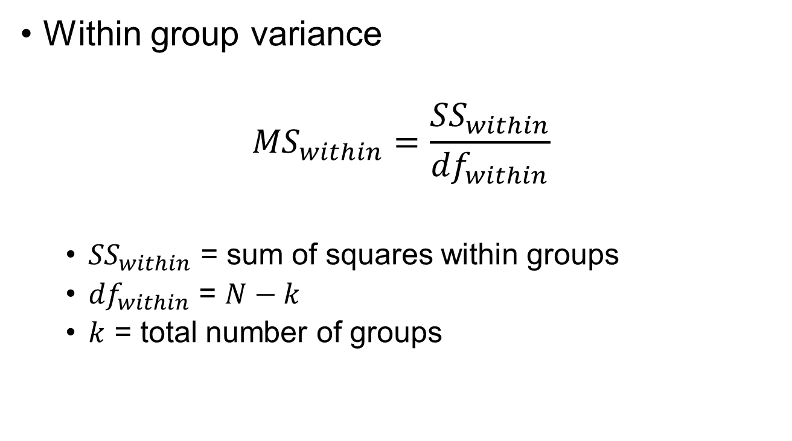
Within Group Variance
Within group variance
$${MS}_{within}=\frac{{SS}_{within}}{{df}_{within}}$$
${SS}_{within}$ = sum of squares within groups
${df}_{within}$ = $N−k$
$k$ = total number of groups

Slide 5
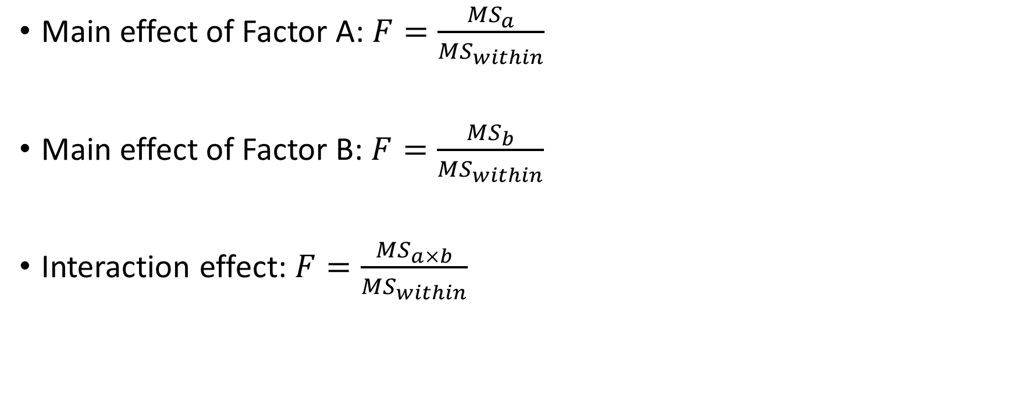
Computing F-statistics
Main effect of Factor A: $F=\frac{{MS}_{a}}{{MS}_{within}}$
Main effect of Factor B: $F=\frac{{MS}_{b}}{{MS}_{within}}$
Interaction effect: $F=\frac{{MS}_{a×b}}{{MS}_{within}}$

Slide 6
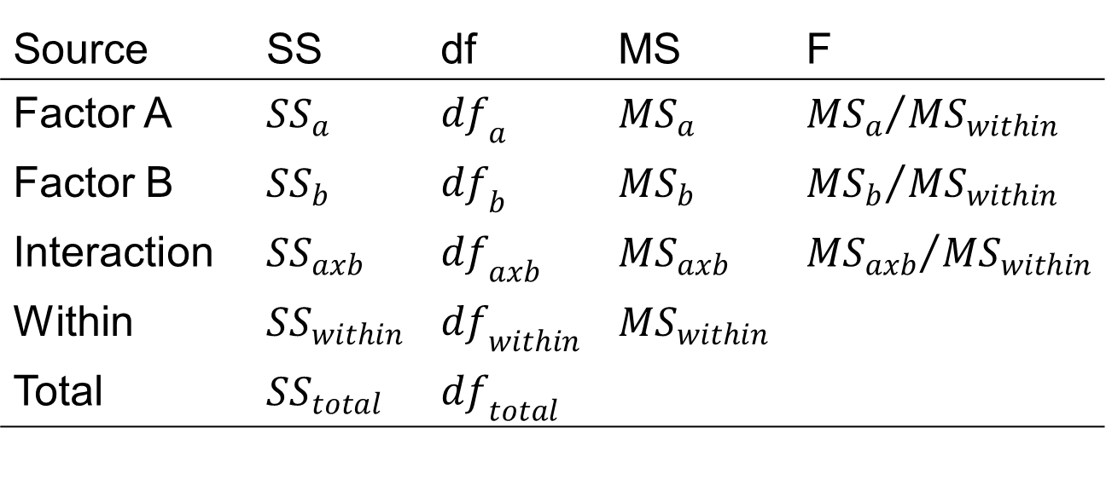
Two-Way ANOVA Summary Table
Source | SS | df | MS | F
Factor A | $$SS_{a}$$ | $$df_{a}$$ | $$MS_{a}$$ | $${MS_{a}}/{MS_{within}}$$
Factor B | $$SS_{b}$$ | $$df_{b}$$ | $$MS_{b}$$ | $${MS_{b}}/{MS_{within}}$$
Interaction | $$SS_{axb}$$ | $$df_{axb}$$ | $$MS_{axb}$$ | $${MS_{axb}}/{MS_{within}}$$
Within | $$SS_{within}$$ | $$df_{within}$$ | $$MS_{within}$$
Total | $$SS_{total}$$ | $$df_{total}$$

Slide 7
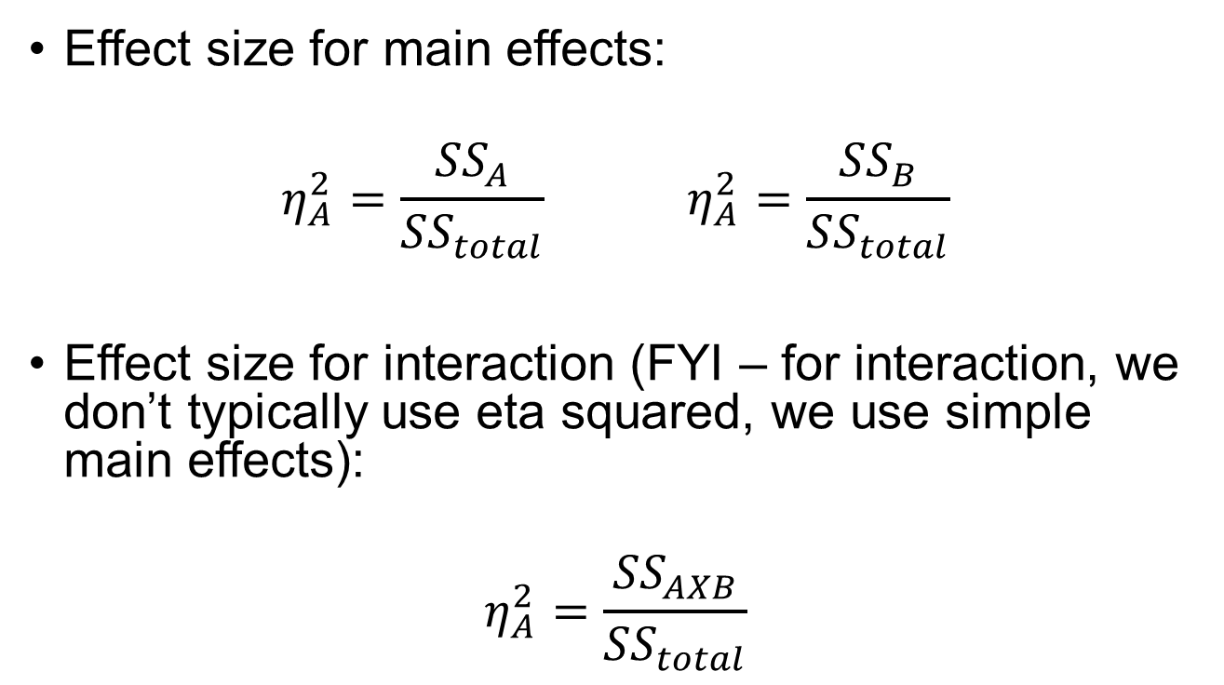
Effect Size
Effect size for main effects:
$$η_{A}^{2}=\frac{{SS}_{A}}{{SS}_{total}} η_{A}^{2}=\frac{{SS}_{B}}{{SS}_{total}}$$
Effect size for interaction (FYI – for interaction, we don’t typically use eta squared, we use simple main effects):
$$η_{A}^{2}=\frac{{SS}_{AXB}}{{SS}_{total}}$$

